Slide 1
IIUC TECH FEST
Inter University Mobile Games and Apps Development Competition
TEAM NAME
N-CUBE
TEAM LEADER & OTHER TEAM MEMBERS
MOHAMMAD IFTAKHAR KABIR SAKUR

Slide 2
TITLE OF THE PROJECT
THE DEAD HALL

Slide 3

ABOUT THE GAME
THE GAME IS ABOUT A HALL, WHICH WAS THE CENTRAL RESEARCH CENTER FOR THE COUNTRY BACK IN 2023.YOU WILL BE PLAYING IN THE YEAR 2160.IT IS TO SAY,ONLY YOU SURVIVED FROM THE EXPERIMENT THAT WAS DONE BY THE SCIENTIST “THE GREAT DRAGO”.AND YOU HAD BEEN IN SLEEP SINCE THEN.BUT SUDDENTLY YOU HAVE WOKEN UP.
NOW,YOUR TASK IS TO KILL “THE GREAT DRAGO” WHO ALSO BECAME HALF DEAD (TO STOP THIS EXPERIMENT).

Slide 4
WHO IS “THE GREAT DRAGO”?
HE WAS THE MAIN SCIENTIST OF THE RESEARCH CENTER.BUT HE WANTED TO BE A POWERFUL PERSON ALWAYS.AS A RESULT HE DID THE BANNED EXPERIMENT TO HAVE HIS OWN ARMY.

Slide 5
WHO ARE YOU(PLAYER)?
YOU WERE THE CHIEF OF SECURITY INTELLIGENT OF THE RESEARCH CENTER.

Slide 6
GAME OVERVIEW
WE WILL BE SEEING ALL THE THINGS THAT WAS RELATED TO THIS GAME PROJECT:
->TITLE SCENE
->DIFFERENT BUTTON’S WORKING PROCESS
->MENU
->AI PLAYER AND HOW THEY MOVES THROUGHOUT THE GAME
->DIFFERENT LEVELS AND THEIR MAPS
->THE PLAYER’S MOVEMENT & RIFLE
->HOW TO MOVE TO THE NEXT LEVEL & END THE GAME
->THE GREAT DRAGO
->ENDING PART
->PAUSE AND PLAY BUTTON
->ABOUT BUTTON
->GAME QUITTING

Slide 7
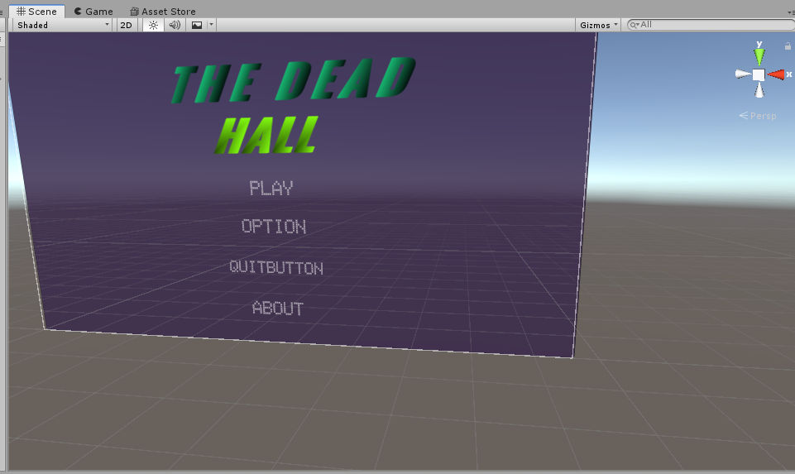
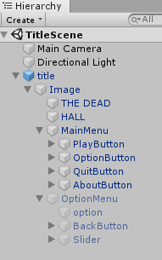
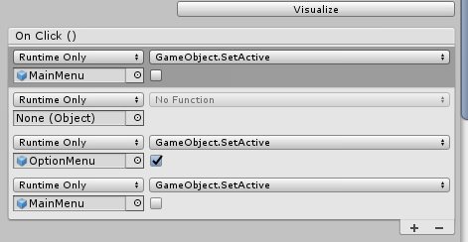
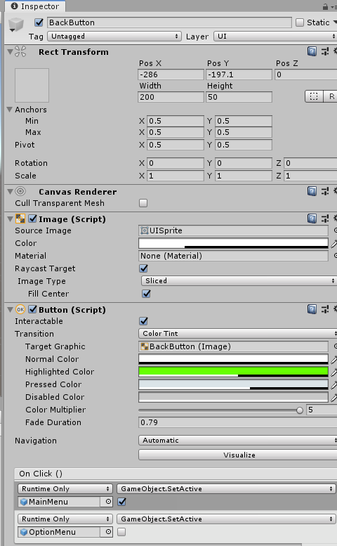
TITLE SCENE
THE HIERARCHY OF THE MEANU BUTTON
INNER WORK FOR THE BUTTON TO WORK
THE INNER SETTINGS FOR BACK BUTTON
THE TITLE SCENE

Slide 8
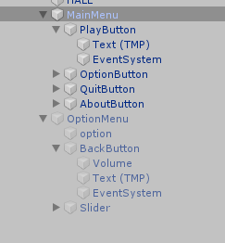
DIFFERENT BUTTON AND THEIRWORKS
MENU BUTTON
THE HIERARCHY OF THE MAINMENU BUTTON
THE MAINMENU OF THE GAME

Slide 9
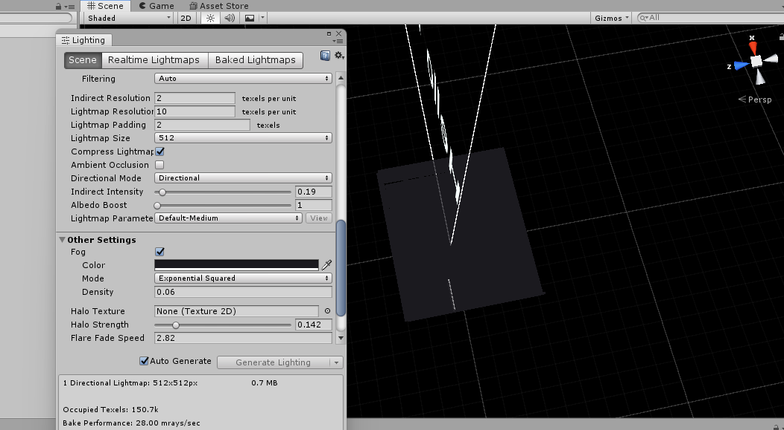
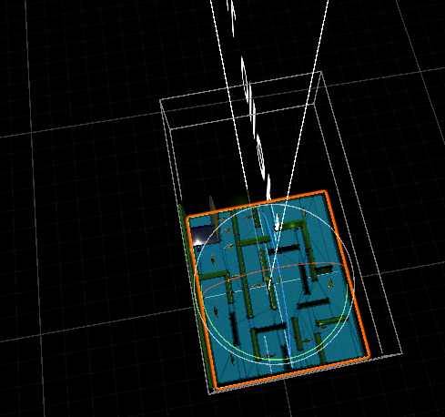
ALL LEVELS & THEIR MAPS
LEVEL-01
THE MAP IS INVISIBLE AS I USED FOG IN HERE
LEVEL-01 MAP

Slide 10
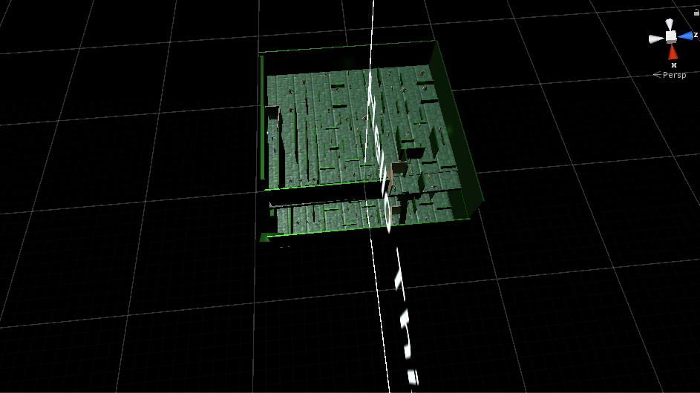
ALL LEVELS & THEIR MAPS
LEVEL-02
LEVEL-02 MAP

Slide 11
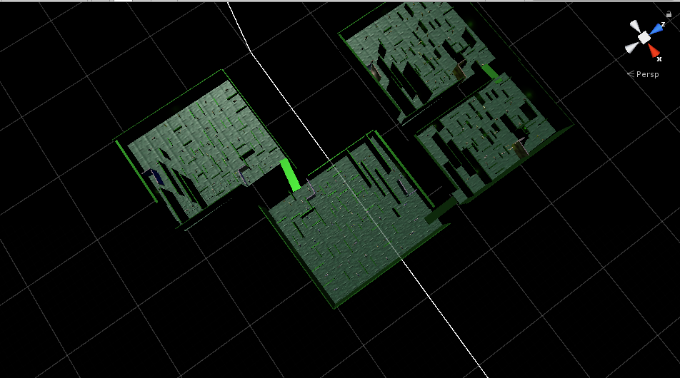
ALL LEVELS & THEIR MAPS
LEVEL-03
LEVEL-03 MAP

Slide 12
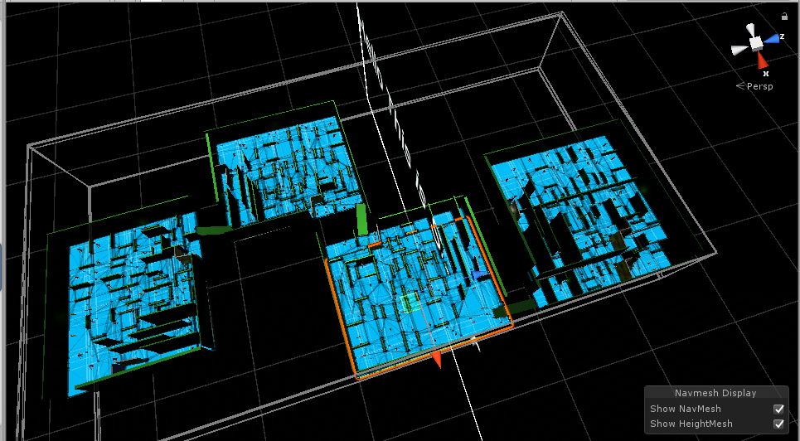
ALL LEVELS & THEIR MAPS
LEVEL-04
LEVEL-04 MAP

Slide 13
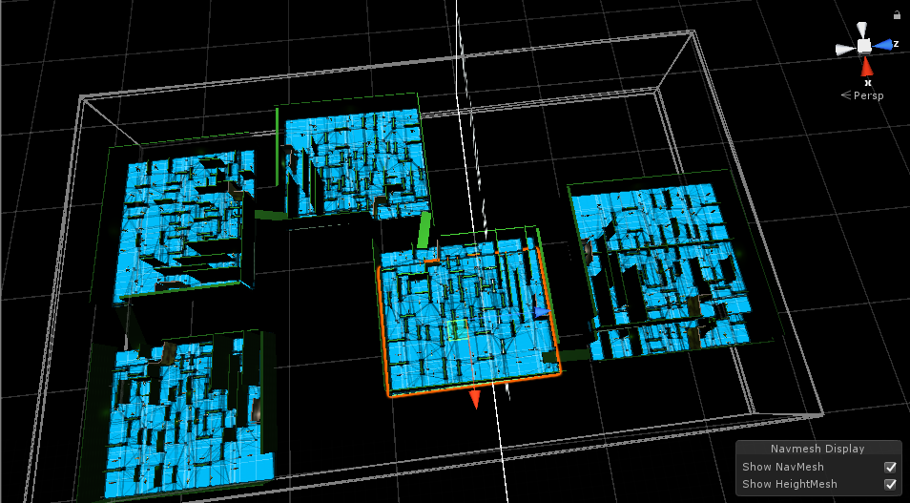
ALL LEVELS & THEIR MAPS
LEVEL-05
LEVEL-05 MAP

Slide 14
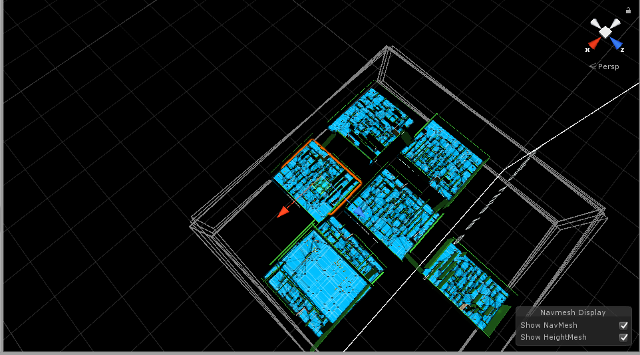
ALL LEVELS & THEIR MAPS
LEVEL-06
LEVEL-06 MAP

Slide 15
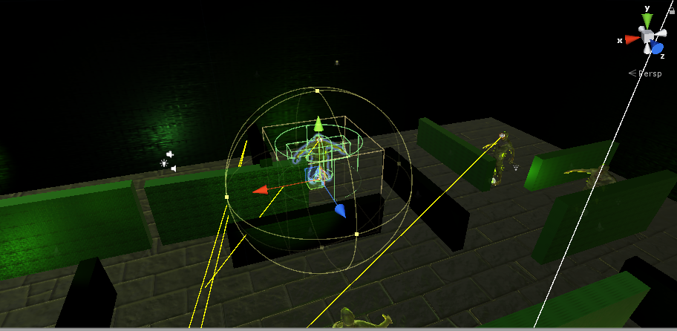
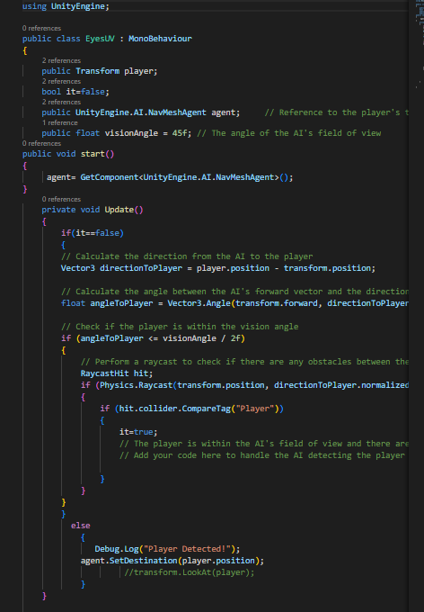
AI PLAYER AND THEIR MOVEMENT
PLAYER’S DETECTION
AI PLAYER DETECTION THROUGH RAY
SCRIPT FOR THE PLAYER DETECTION

Slide 16
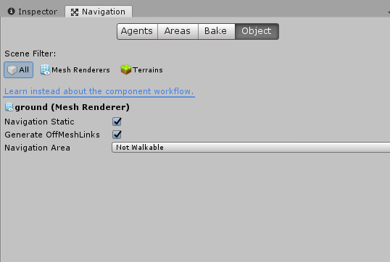
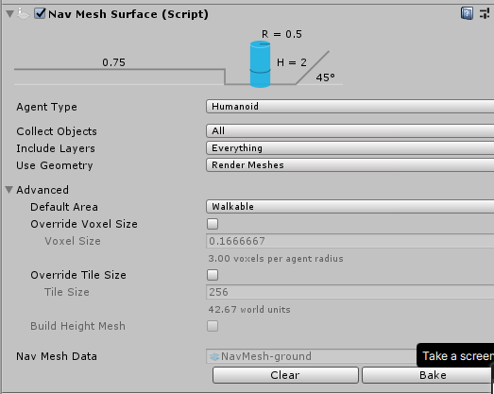
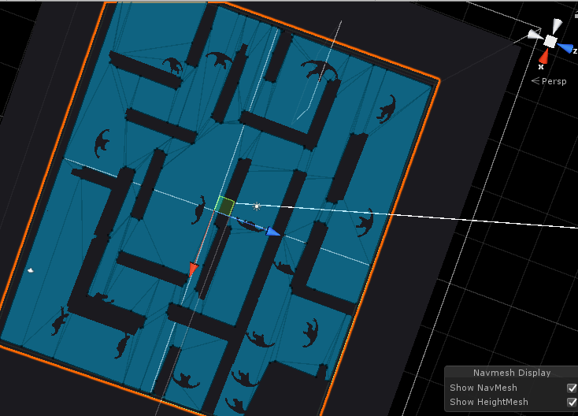
AI MOVEMENT ON THE SURFACE
TO MOVE DIFFERENT PLACES I USED NAVMESH HERE.IT IS AN INBUILT SYSTEM OF THE UNITY
THE AI NAVIGATION SYSTEM OF UNITY
NAVMESH SURFACE(USED IN THR GROUND)
THIS IS HOW IT LOOKS LIKE AFTER USING THE SYSTEM

Slide 17
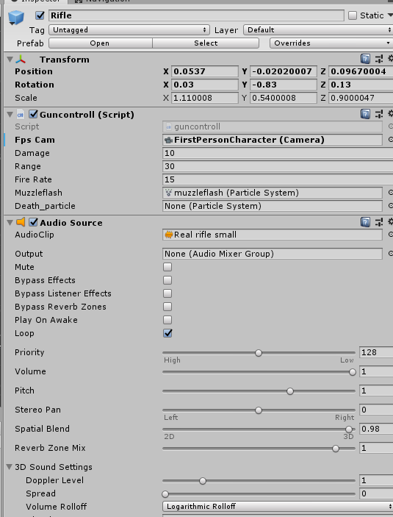
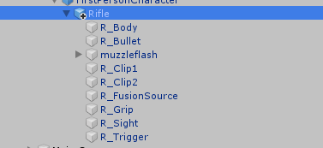
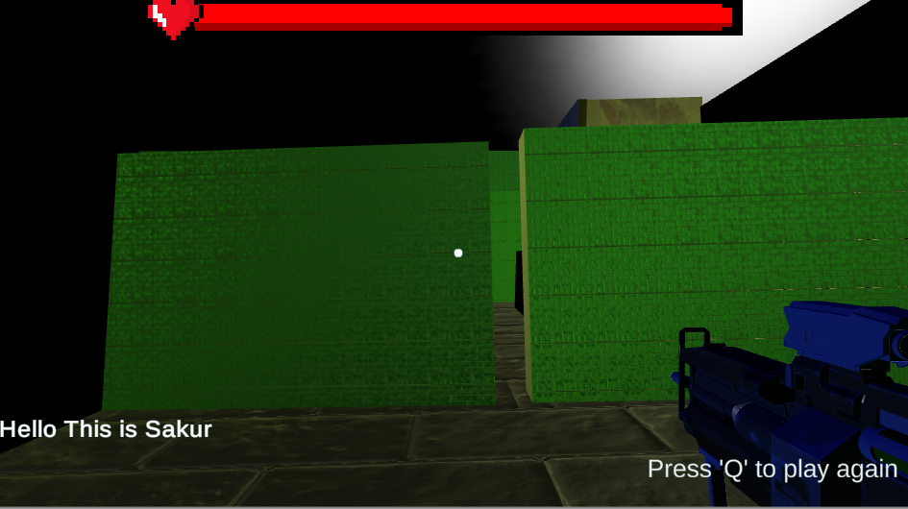
PLAYER’S MOVEMENT AND RIFLE
THE HIERARCHY OF THE RIFLE
RIFLE IN THE GAMESCENE
THE SETTING FOR THE RIFLE

Slide 18
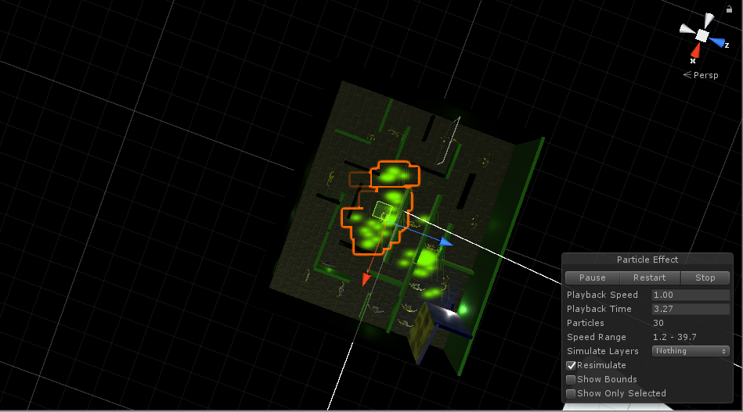
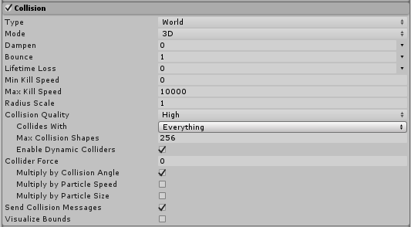
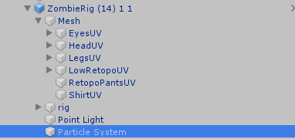
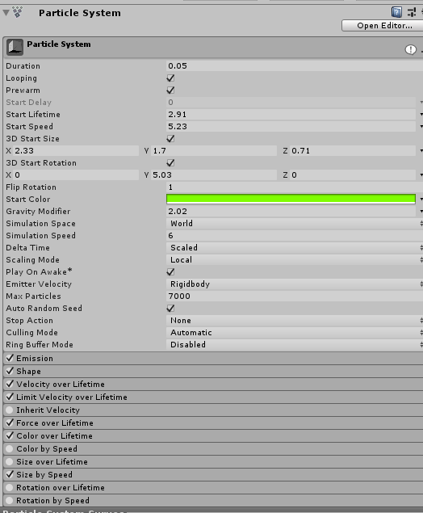
THE ZOMBIE POWER(FLAME)
THE ZOMBIE HAS A POWER TO KILL THE PLAYER AND THAT IS THEIR FLAME
HIERARCHY OF THE ZOMBIE
THE FLAME OF THE ZOMBIE
THE COLLISION FOR THE FLAME
PARTICLE SYSTEM

Slide 19
PAUSE AND PLAY
IF YOU PRESS THE BUTTON ‘Q’ THEN YOU GO TO THE NEXT ROUND

Slide 20
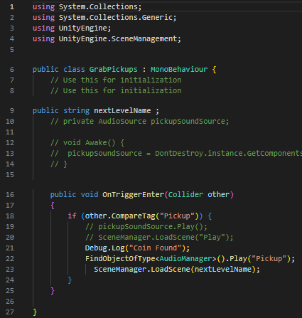
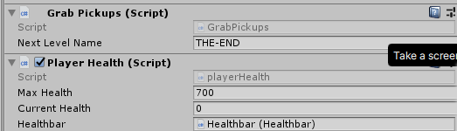
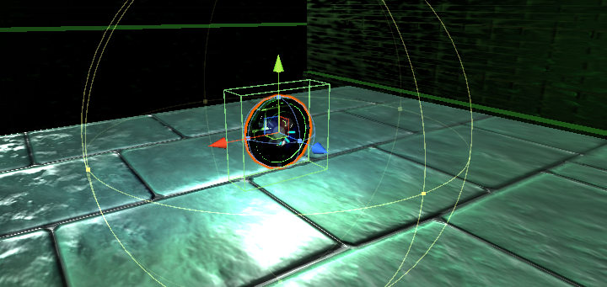
PICKUP AND GOING TO THE NEXT LEVEL
COIN IF YOU COLLIDE YOU WILL MOVE TO THE NEXT LEVEL IF IT THE LAST LEVEL THEN YOU KILL ALL ZOMBIES
THE SCRIPT OF THE COIN ATTACH TO THE PLAYER
THE SCRIPT OF THE COIN

Slide 21
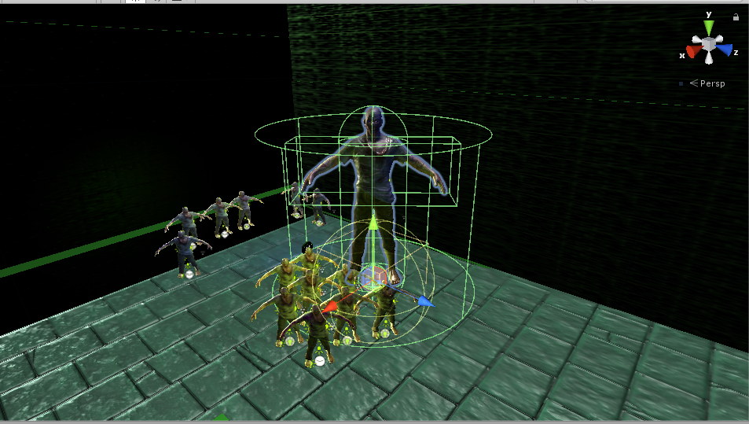
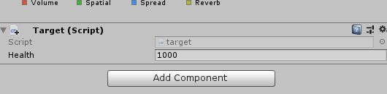
THE GREAT DRAGO
THE SIZE OF ‘THE GREAT DRAGO’ WITH OTHER ZOMBIES
THE POWER OF THE GREAT DRAGO

Slide 22
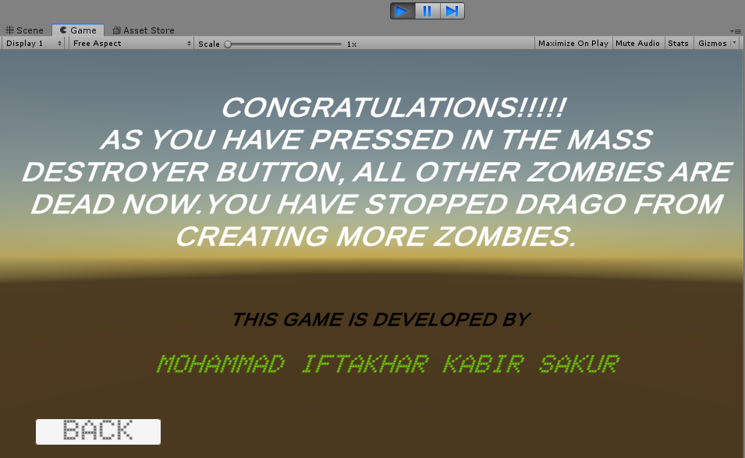
THE ENDING PART
AS SOON AS YOU COLLIDE WITH THE MASS DESTRUCTION COIN IN THE LAST LEVEL THIS ENDING SCENE APPEARS

Slide 23
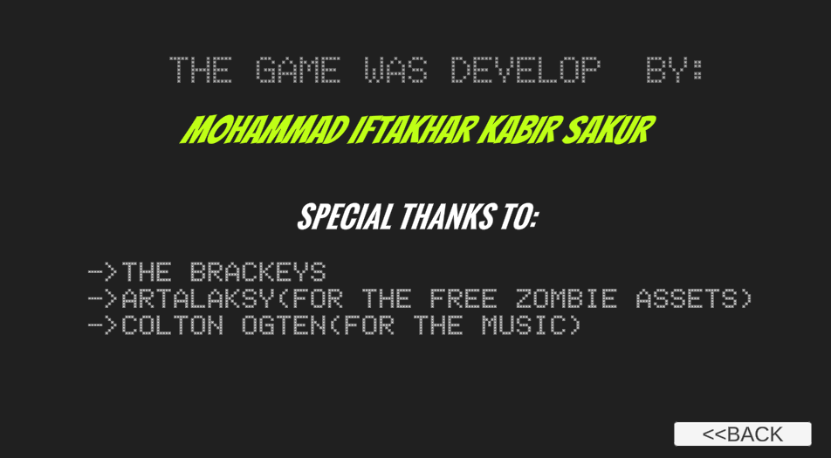
THE ABOUR BUTTON AND QUITTING THE GAME
IF YOU CLICK ON THE ABOUT BUTTON THIS SCENE APPEARS THERE IS ALSO A QUIT BUTTON WHICH HELPS TO SKIP THE GAME

Slide 24
THANK YOU VERY MUCH

Slide 25
ANY QUESTIONS?

